Slide 1
Dump those other tools!
Presentation by Hussein Farran

Slide 2
Why we are here.
Learn about LINQPad software and its basic feature set.
Develop an understanding of how LINQPad can be useful to a .NET developer in day-to-day business.
Develop an understanding of how LINQPad can be useful to a SQL administrator in day-to-day business.
Discover and play with interesting features of LINQPad.
Introduce, but not dive too deeply into, advanced uses of LINQPad.
Law of two feet.

Slide 3


Who am I? Why should you care?
Cloud Software Developer at Lippert Technologies.
Programming for 10+ years, in the biz for 5+.
Has a stupid cat.
.NET developer by day, technology dabbler by night.
Wait, that sounds weird. I just like to try things out.
Not a LINQPad salesperson, I promise.

Slide 4
What is LINQPad? Why should you care?
Putting up here first and foremost: Windows only.
LINQPad is a software companion for .NET and SQL developers.
Bonus points if you’re proficient in both!
LINQPad allows for easily writing and executing .NET code, outside of Visual Studio/Rider/VSCode.
Use LINQPad to prototype new features or test existing code.
LINQPad also functions very nicely as a scripting tool to perform actions quickly and easily.

Slide 5
What can LINQPad do?
Execute .NET code as if it were a script.
Access databases and perform all sorts of CRUD.
Provides you with tools to easily write and debug code.
Output to rich text or to data grids.
Integrated debugger!
Autocomplete makes for a pleasant experience.
NuGet integration makes finding and using packages easy.
Auto-importing namespaces for unresolved types.
Custom and built-in snippets.
Edit data right in the data grid.

Slide 6

Sold yet? No? Here’s how to get it anyway.
Download at https://www.linqpad.net/
Available in multiple editions: Free, Pro, Developer, and Premium.
Quick pitch:
Go Pro if you’re a power user with some .NET experience.
Go Developer if you’re a .NET developer with SQL background and need a quicker tool than SSMS.
Go Premium if you are a .NET developer who wants a scripting and coding scratchpad for multiple uses.

Slide 7
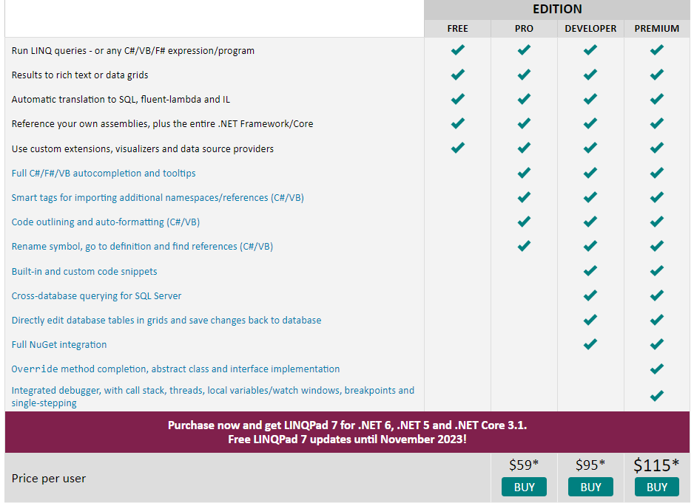
Comparison of LINQPad editions.

Slide 8
Let’s see how it all works…
Please turn your employee handbook to page 12 to begin the onboarding experience.

Slide 9
Where can I learn more?
linqpad.net gives great resources.
https://www.linqpad.net/FAQ.aspx
https://www.linqpad.net/Resources.aspx
LINQPad has a built-in samples section.
It goes into much of the same stuff we covered, but more in-depth.

Slide 10
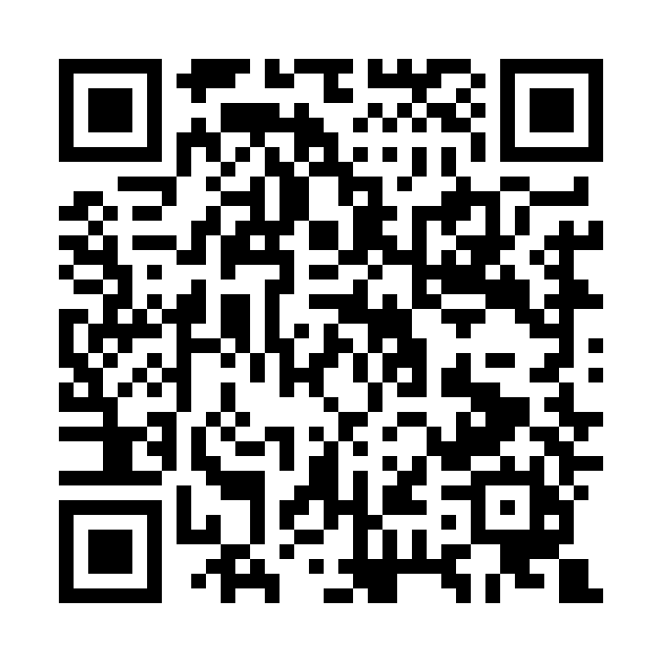
Thank you!
Thanks for sticking it out with me. Please feel free to email me any questions or feedback.
You can reach me at: hmfarran@gmail.com
Slides and the queries written for this talk will be available on my GitHub
https://github.com/Ijwu/DumpThoseOtherTools
Or scan the QR code.

